Slide 1



Noida Institute of Engineering and Technology, Greater Noida
Secure System Development
Unit: 3
Cyber Security
ANC0301
Mr. Sujeet Singh Bhadouria
Assistant Professor
(CSE)
NIET, Gr. Noida
(B Tech IIIrd Sem)

Slide 2

Faculty Profile
FACULTY PROFILE
Name of Faculty: Sujeet Singh Bhadouria
Designation & Department: Assistant Professor, CSE
Qualification: Ph.D (Pre-Submission) M.Tech
Experience: 10 Years of teaching experience
Area of Interest: Computer Network
Reviewer: IET Communications ISSN 1751-8644 (SCI & SCOPUS INDEX)
Research Publications:
International Journal 09
Paper Presentation 06
International Patent 01 (Granted)
National Patent 04

Slide 3
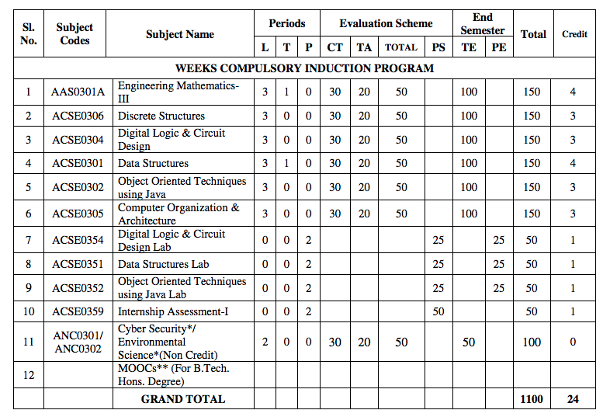
Evaluation Scheme

Slide 4
Syllabus
Introduction:
Introduction to Information Systems: Types of Information Systems, Development of Information Systems, Need for Information Security, Threats to Information Systems, Information Assurance, Guidelines for Secure Password and WI-FI Security and social media and Windows Security, Security Risk Analysis and Risk Management.
Application Layer Security:
Data Security Considerations-Backups, Archival Storage and Disposal of Data, Security Technology-Firewall, Intrusion Detection, Access Control, Security Threats -Viruses, Worms, Trojan Horse, Bombs, Trapdoors, Spoofs, E-mail Viruses, Macro Viruses, Malicious Software, Network and Denial of Services Attack, Security Threats to E-Commerce: Electronic Payment System, e- Cash, Issues with Credit/Debit Cards.

Slide 5
Syllabus
Secure System Development:
Application Development Security, Architecture & Design, Security Issues in Hardware: Data Storage and Downloadable Devices, Mobile Protection, Security Threats involving in social media, Physical Security of IT Assets, Access Control, CCTV and Intrusion Detection Systems, Backup Security Measures.
Cryptography and Network Security:
Public key cryptography: RSA Public Key Crypto with implementation in Python, Digital Signature Hash Functions, Public Key Distribution.
Symmetric key cryptography: DES (Data Encryption Standard), AES (Advanced Encryption Standard), Secure hash algorithm (SHA-1).
Real World Protocols: Basic Terminologies, VPN, Email Security Certificates, Transport Layer Security, TLS, IP security, DNS Security.

Slide 6
Syllabus
Security Policy:
Policy design Task, WWW Policies, Email based Policies, Policy Revaluation Process-Corporate Policies-Sample Security Policies, Publishing and Notification Requirement of the updated and new Policies.
Recent trends in security.

Slide 7
Applications
There are many cyber security real-life examples where financial organizations like banks and social organizations, weather channels etc. have faced cyber-attacks and have lost valuable information and resources. To fix these problems, you'll need comprehensive cyber security awareness.
According to KPMG, the annual compensation for cyber security heads ranges from 2 Cr to 4 Cr annually. The industry also reports a satisfaction level of 68%, making it a mentally and financially satisfying career for most.

Slide 8
Course Objective
Students will learn about :
Security of Information system and Risk factors.
Examine security threats and vulnerability in various scenarios.
Understand concept of cryptography and encryption technique to protect the data from cyber-attack
Provide protection for software and hardware.

Slide 9
Course Outcome
After successful completion of this course student will be able to -
COURSE OUTCOME NO. | COURSE OUTCOMES | Bloom’s Knowledge Level (KL)
CO1 | Analyze the cyber security needs of an organization. | K4
CO2 | Identify and examine software vulnerabilities and security solutions. | K1, K3
CO3 | Comprehend IT Assets security (hardware and Software) and performance indicators. | K2
CO4 | Measure the performance and encoding strategies of security systems. | K3, K5
CO5 | Understand and apply cyber security methods and policies to enhance current scenario security. | K2, K3

Slide 10
Program Outcomes
Engineering knowledge
Problem analysis
Design/development of solutions
Conduct investigations of complex problems
5. Modern tool usage
The engineer and society
Environment and sustainability

Slide 11
Program Outcomes…(cont.)
8. Ethics
Individual and team work
10. Communication
Project management and finance
Life-long learning

Slide 12
CO-PO Mapping
CO-PO Mapping
PO No. CO No. | PO1 | PO2 | PO3 | PO4 | PO5 | PO6 | PO7 | PO8 | PO9 | PO10 | PO11 | PO12
CO1 | 2 | 2 | 1 | 2 | - | - | - | 1 | 2 | 1 | 2 | 2
CO2 | 2 | 2 | 2 | 2 | 2 | 1 | - | 1 | 2 | 1 | 2 | 2
CO3 | 2 | 2 | 1 | 2 | 2 | - | - | 1 | 2 | 1 | 2 | 2
CO4 | 2 | 2 | 1 | 2 | 2 | 1 | - | 1 | 2 | 1 | 2 | 2
CO5 | 2 | 2 | 1 | 2 | 2 | - | - | 1 | 2 | 1 | 2 | 2
*3= High *2= Medium *1=Low

Slide 13
Program Specific Outcomes
Program Specific Outcomes (PSOs) are what the students should be able to do at the time of graduation. The PSOs are program specific. PSOs are written by the department offering the program.
On successful completion of B. Tech. (CSE) Program, the Information and Technology engineering graduates will be able to:
PSO1 : Work as a software developer, database administrator, tester or networking engineer for providing solutions to the real world and industrial problems.
PSO2 : Apply core subjects of information technology related to data structure and algorithm, software engineering, web technology, operating system, database and networking to solve complex IT problems
PSO3 : Practice multi-disciplinary and modern computing techniques by lifelong learning to establish innovative career
PSO4 : Work in a team or individual to manage projects with ethical concern to be a successful employee
or employer in IT industry.

Slide 14
PSO Mapping
Program Specific Outcomes and Course Outcomes Mapping
CO | PSO1 | PSO2 | PSO3 | PSO4
CO1 | 2 | 2 | - | 2
CO2 | 2 | 2 | 1 | 2
CO3 | 2 | 2 | - | 2
CO4 | 2 | 2 | - | 2
CO5 | 2 | 2 | - | 2
*3= High *2= Medium *1=Low

Slide 15

Program Educational Objectives
The Program Educational Objectives (PEOs) of an engineering degree program are the statements that describe the expected achievements of graduates in their career, and what the graduates are expected to perform and achieve during the first few years after graduation.
PEO1: To have an excellent scientific and engineering breadth so as to comprehend, analyze, design and solve real-life problems using state-of-the-art technology.
PEO2: To lead a successful career in industries or to pursue higher studies or to understand entrepreneurial endeavors.
PEO3: To effectively bridge the gap between industry and academics through effective communication skill, professional attitude and a desire to learn.

Slide 16
Result Analysis
Faculty Name | Subject Name | Code | Result
Ms Ruchika Sharma | Cyber Security | ANC0301 | 100%

Slide 17
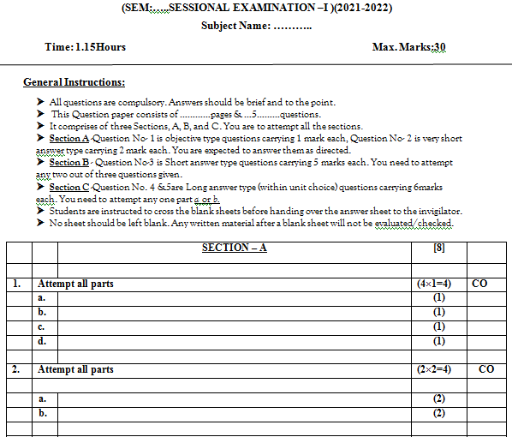
Question Paper Template

Slide 18
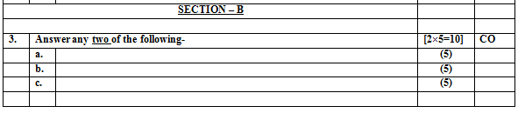
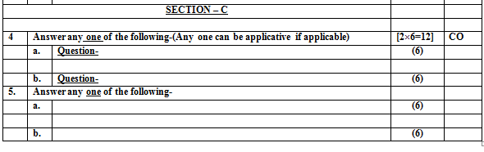
Question Paper Template

Slide 19
Prerequisite/Recap
Basics recognition in the domain of Computer Science.
Concept of network and operating system.
Commands of programming language.

Slide 20
Brief Introduction about the Subject
Modern life depends on online services, so having a better understanding of cyber security threats is vital.
The course will improve your online safety in the context of the wider world, introducing concepts like malware, trojan virus, network security, cryptography, identity theft, and risk management.
https://www.javatpoint.com/cyber-security-introduction
https://www.edureka.co/blog/what-is-cybersecurity/
http://natoassociation.ca/a-short-introduction-to-cyber-security/

Slide 21
Unit Content
Developing Secure Information Systems
Application Development Security,
Information Security Governance & Risk Management,
Security Architecture & Design
Security Issues in Hardware, Data Storage & Downloadable Devices,
Physical Security of IT Assets, Access Control, CCTV and Intrusion Detection Systems
Backup Security Measures.

Slide 22
Unit Objective
Topic | Objective
Application Development Security | Develop an understanding of Secure Information System Development and integration of security in development phases
IS Governance & Risk Management | Study of Information Security Governance & Risk Management
Security Architecture & Design Security Issues in Hardware | Examine the Security Architecture and Design Security Issues in Hardware
Data Storage | Understand the security issues in data storage and Downloadable Devices
Physical Security of IT Assets | Develop an understanding of Access Control, CCTV and IDS
Backup Security Measures | Study of concept of Backup Security Measures

Slide 23
Objective of Topics
Topic | Objective | CO Mapping
Application Development Security | Develop an understanding of Secure Information System Development and integration of security in development phases | CO3

Slide 24
Prerequisite
Denial of Services Attack
Threats to E-Commerce
Mobile, cloud security

Slide 25
Secure Information System Development(CO3)
During secure system development, stakeholders have to decide and select the development activities.
Traditional system and software engineering lifecycles, such as Waterfall, V-model, Spiral, Prototype development, Agile, Incremental development, could be a good starting option. However, traditional development lifecycles do not take into account security concerns in particular.
Therefore, there exist approaches which focus on security development techniques, methods, and tools. The three secure system development lifecycles:
Microsoft Secure System Development Lifecycle
Open Web Application Security Project (OWASP) and Comprehensive Lightweight Application Security Process (CLASP)
Seven Touchpoints for Software Security

Slide 26
Integration of Security in SDLC Phases
Elicitation Phase
Maintenance Phase
Security in
SDLC
Analysis Phase
Implementation Phase
Design Phase
Source: Springer link

Slide 27
Integration of Security in SDLC Phases
The Elicitation Phase:
Determines the security requirements of the software application by executing a simple risk analysis exercise
Information asset identification and valuation
Threat identification and assessment
Risk (asset/threat) identification
Determine the level of vulnerability
Risk assessment
Risk prioritisation.

Slide 28
Integration of Security in SDLC Phases
The Analysis Phase:
Determines the security services to be used to satisfy the security requirements;
During the analysis phase, security services are selected according to their ability to mitigate the security risks identified.
The output of this phase is a refined set of security requirements.
Identify the relevant security services and level of protection required to mitigate each risk

Slide 29
Integration of Security in SDLC Phases
The Design Phase:
determines how the security services will be implemented
• Map security services to security mechanisms;
• Consolidate security services and mechanisms.
The Implementation Phase:
Identifies and implements appropriate software security tools and components
Map security mechanisms to software security components.

Slide 30
Integration of Security in SDLC Phases
The Maintenance phase :
During this phase, it is important to find ways to evaluate the security of the system to ensure that the system is as secure as intended
Improve the auditability of the software application .
Users and operations staff need to be educated in using the software application in a secure manner.

Slide 31
Application Development Security (CO3)
Information is available for organizations in the form of assets, which need to be used (collected, stored, shared, and deleted) in an intelligent manner.
An intelligent use of information assets helps organizations in maintaining themselves ahead of their competitor organizations.
Therefore, these assets need to be protected from any kind of threats that may result into breach of confidentiality, integrity, or availability of resources.

Slide 32
Issues related to the secure development of applications
Less trained/ skilled developers
Less educational focus on secure development
Difficulty of finding the right information related to specific security measures for particular applications or application development strategies.
Lifecycle systems considering security mostly in the last phases only.

Slide 33
Common Framework for Application Security
Secure applications can be developed by following certain specifications that contains foundation, principles, and design guidelines.
Foundation: Foundation is the basic knowledge of the development procedure and security issues to consider before starting to develop the application.
Principles: Principles are the basic rules to be followed during the application development process.
Design Guidelines: Design guidelines include the best code implementation methods that are tested and have been proven successful over time.

Slide 34
Daily Quiz
What is application security?
Mention some Information Security consideration?
What is SDLC?

Slide 35
Topic Links
https://youtu.be/snJGzyXzVec
https://youtu.be/8caqok3ah8o

Slide 36
Recap
Integration of Security in SDLC Phases(Sec SDLC)
Elicitation Phase
Analysis Phase
Design Phase
Implementation Phase
Maintenance Phase

Slide 37
Objective of Topics
Topic | Objective | CO Mapping
Security Architecture & Design Security Issues in Hardware | Examine the Security Architecture and Design Security Issues in Hardware | CO3

Slide 38
Architecture and Design (CO3)
Security Architecture Components-
- Hardware
- Operating System
- Software

Slide 39
Architecture and Design (CO3)
Security Architecture and Design
Hardware and Software
Models
Evaluation Methods
Describes the level of security of a system.
Explains the way to maintain the security of this system
Provides the way to design secure system

Slide 40
Concepts for Secure System Design
1- Layering:
Layering is a concept that arranges hardware, drivers for kernel and devices, operating system, and applications in a sequential order.
The layering approach is used to differentiate the hardware from the software into different tiers.
A generic list of security architecture layers is as follows
1. Hardware (bottom layer)
2. Kernel (a part of OS) and device drivers
3. Operating System
4. Application software (Top Layer)

Slide 41
Concepts for Secure System Design
2-Abstraction :
The purpose of abstraction is to hide unnecessary details from users.
We will only increase the risk of threats if we increase the complexity of the system.
Abstraction provides a way to manage that complexity.
– For example ,while music is being played from a file through the speaker of the computer system. The user is only concerned with playing of music just with click without knowing the internal working of music player.

Slide 42
Concepts for Secure System Design
3-Security Domain :
A security domain is the list of objects a subject is allowed to access.
With respect to kernels, two domains are user mode and kernel mode.
Kernel mode (also known as supervisor mode) is where the kernel lives, allowing low-level access to memory, CPU, disk, etc. It is the most trusted and powerful part of the system.
User mode is where user accounts and their processes live. The two domains are separated: an error or security lapse in user mode should not affect the kernel.

Slide 43
Concepts for Secure System Design
4-The Ring Model:
The ring model is a form of CPU hardware layering that separates and protects domains (such as kernel mode and user mode) from each other.
Many CPUs, such as the Intel 86 family, have four rings, ranging from ring 0 (kernel) to ring 3.
The rings are (theoretically) used as follows:
Ring 0: Kernel
Ring 1: Other OS components that do not fit into ring 0
Ring 2: Device drivers
Ring 3: User applications

Slide 44
Concepts for Secure System Design
5- Open and Closed Systems:
An open system uses open hardware and standards, using
standard components from a variety of vendors.
Ex - Assembled Desktop computer
Close systems- only use proprietary hardware or software from specific vendor.
– Ex- Branded Desktop (HP)

Slide 45
Daily Quiz
What does secure architecture design means?
What are Security Issues with Hardware?
What is security analysis?
What are the principles for secure system design?

Slide 46
Weekly Assignment
What do you mean by Application Security? Name the two protocol use for Email Security and Explain?
Elaborate the term access control? What is include in authorization process for (File, Program, Data rights) and explain the all types of control?
Define Vendor challenges and user challenges for application security?
Write a short note on data disposal.
What do you mean by physical security of IT assets?
Explain Information security governance.
Write design Security Issues in Hardware, Data Storage & Downloadable Devices?
What are the different Measures of Backup Security
What are the different types of Biometric?
Explain the Principles for Secure System Design

Slide 47
Topic Link
https://youtu.be/cUvMIOdaSBs

Slide 48
Security Issues with Hardware (CO3)
Hardware mainly faces security issues related to:
-Stealing
-Destruction,
-Gaining unauthorized access
-Breaching the security code of conduct.
Example- if an organization has given laptops to some of its employees, it can be possible that they are using their laptop for illegitimate activities, which result into threats for the organizations’ data integrity and confidentiality.

Slide 49
Ways to Secure Hardware
Locks and access control mechanisms-
Biometric access control,
Authentication codes/tokens,
Radio Frequency Identification (RFID), etc.
You also need to apply Local intranet and Virtual Private Networks (VPNs) to provide complete security for your system.
However, network routers are also subjected to eavesdropping and other kinds of attack that may harm your organization’s internal security.

Slide 50
Daily Quiz
What is hardware security?
Differentiate breaching and stealing.

Slide 51
Topic Link
https://youtu.be/Ye2H1n2MtIc
https://youtu.be/xwgecIX3E4I

Slide 52
Objective of Topics
Topic | Objective | CO Mapping
Data Storage and Downloadable Devices | Understand the security issues in data storage and Downloadable Devices | CO3

Slide 53
Security Issues with Downloadable (Peripheral)Devices (CO3)
Peripheral devices : The term peripheral device refers to all hardware components that are attached to a computer and are controlled by the computer system, but they are not the core components of the computer.
Peripherals can also be defined as devices that can be easily removed and plugged into a computer system. Types are:
Input device sends data or instructions to the computer, such as Mouse, Keyboard, Scanner.
Output device provides output data from the computer, such as a Monitor, printer, projector.
Storage Device which performs both input and output functions, such as CDs, DVDs, Pen drive, Memory card.

Slide 54
Security Issues with Downloadable (Peripheral)Devices (CO3)
.The threats to the security of data storage devices can be External or Internal.
Internal : If you have stored some data on a CD and some unauthenticated user gets access to that CD, he/she may use it unlawfully. If the device has inbuilt security mechanisms, then it can be destroyed, thereby resulting in loss of some crucial data. This can create problems for data integrity and availability.
External : In external threat, unseen entity can create a change which cannot be easily detected. Such change of information if is allowed in the data storage device, then a person may alter the data in such a way that it is no longer available for authenticated users.

Slide 55
Security Issues with Downloadable (Peripheral)Devices (CO3)
Their loss and theft, disposal, stealing of data, denial of data, malware introduction, etc.
Specific security measures should be applied to protect information from being damaged, stolen, or corrupted by internal or external threats.

Slide 56
Introduction to Mobile Device Security(CO3)
At present around the world, up to five billion people are using mobile phones
This has led to the rapid increase of cyber criminals
They make use of the information obtained through mobile phones to earn profit and pushing users to become victims of cybercrimes
Hence, mobile users must be aware of the potential threats caused by the cybercriminals as they are usually casted in wide nets

Slide 57
Various Attacks on Mobile Devices
Attacks on Mobile Devices
Operating System Attacks
Mobile App Attacks
Communication Network Attacks
Malware Attacks

Slide 58
Components of Mobile Device Security
Mobile Device Security
Endpoint Security
Cloud Access Security Broker (CASB)
Email Security
Secure Web Gateway
Virtual Private Network (VPN)

Slide 59
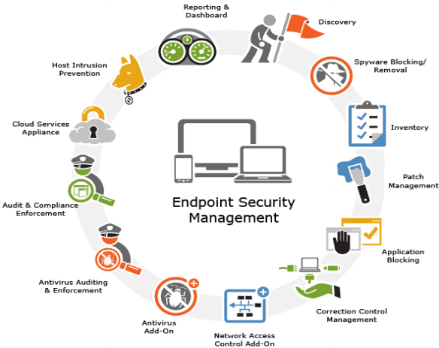
Components of Mobile Device Security
Endpoint security
Source: swayam

Slide 60
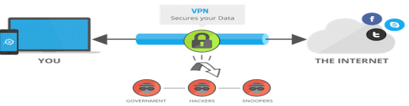
Components of Mobile Device Security
VPN
Source: swayam

Slide 61
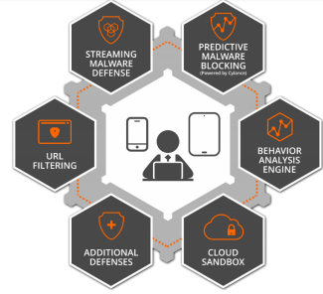
Components of Mobile Device Security
Secure web gateway
Source: swayam

Slide 62

Components of Mobile Device Security
Email security
Source: swayam

Slide 63
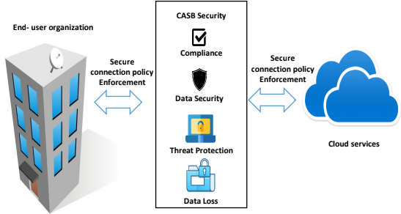
Components of Mobile Device Security
Cloud Access Security Broker (CASB)
Source: swayam

Slide 64
Common Mobile Device Security
Threats
Data leakage
Improper session handling
Unsecured Wi-Fi
Reasons for Data Loss
Broken cryptography
Network spoofing
Spyware
Phishing attacks

Slide 65
Common risks in Mobile Devices
Mobile Device Risks
Physical
security
Bluetooth
attacks
Malware on rise
Serious
threats in
new
features
Mobile
device
coding
issues
Multiple
user
logging
Secure
data
storage
Mobile
browsing
Application
isolation
System
updates

Slide 66
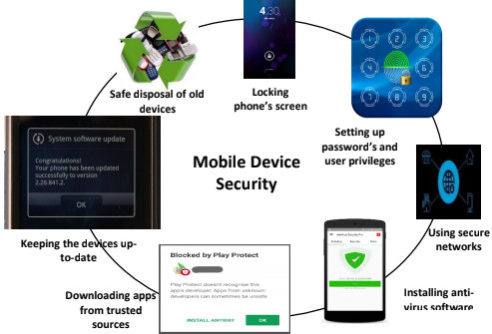
Steps to maintain Mobile Device Security
Source: swayam

Slide 67
Recap
Security Architecture Components
Security Architecture and Design
Concepts for Secure System Design
Secure Issues with Downloadable devices

Slide 68
Daily Quiz
What are security issues with storage devices?
What are security issues with peripheral devices?

Slide 69
Weekly Assignment
What do you mean by Application Security? Name the two protocol use for Email Security and Explain?
Elaborate the term access control? What is include in authorization process for (File, Program, Data rights) and explain the all types of control?
Define Vendor challenges and user challenges for application security?
Write a short note on data disposal.
What do you mean by physical security of IT assets?
Explain Information security governance.
Write design Security Issues in Hardware, Data Storage & Downloadable Devices?
What are the different Measures of Backup Security
What are the different types of Biometric?
Explain the Principles for Secure System Design

Slide 70
Topic Link
https://youtu.be/Ye2H1n2MtIc
https://youtu.be/xwgecIX3E4I

Slide 71
Objective of Topics
Topic | Objective | CO Mapping
Physical Security of IT Assets | Study of concept of Physical Security of IT Assets | CO3

Slide 72
Physical Security of IT Assets(CO3)
When it comes to providing security to your IT assets, you should keep it as simple, coherent, and standardized as possible. The primary threats for the physical security are as follows:
Physical access exposure to human beings:
Organizations’ own employees => theft, fraud, accidents, and sabotage.
Data Tampering by unauthorized users
Physical access exposure to natural disasters:
Natural disasters may destroy your computer systems or all data storage systems.
They might even interrupt your network. (fire, lightening, or electric interruption)

Slide 73
Mechanisms to Solve Physical Security
Physical access controls :
The physical access control measures can be applied in various forms, such as locks, biometric authentication systems, photo IDs, Entry logs, magnetic locks using electronic key card, and computer terminal locks.
Electronic and visual surveillance systems: Through closed circuit television(CCTV), RFID sensors
CCTV cameras are also called the third eye because if human being missed noticing some people entering a restricted zone, these cameras could capture the event or photos.
Intrusion Detection Systems (IDS): IDS is a way of dealing with unauthorized access to information system assets.

Slide 74
Biometrics and its types
Biometrics involves something a person is, or a person does
It recognizes people based on two types
Physiological characteristics - fingerprints, face, retina, iris
Behavioural characteristics - gait, signature
Another class of biometrics is esoteric biometrics - vein pattern, lip print, brain wave pattern

Slide 75
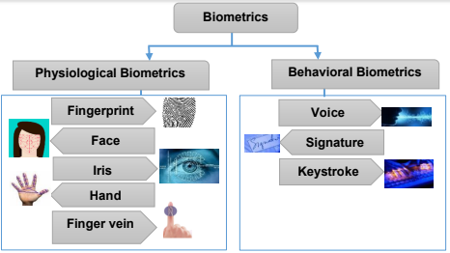
Biometrics and its types
Source: swayam

Slide 76
Access Control(CO3)
Access control is a mechanism that defines and controls access rights for individuals who can use specific resources in the OS.
The access control is a security feature through which the system permits or revokes the right to access any data and resource in a system.
The permission to access a resource is called authorization.

Slide 77
Access Control
Access control
systems
File permissions
Program permissions
Data rights permissions
User can create, read, edit, or delete file on the server
User can execute a program on an application server
User can retrieve or update information in a database

Slide 78
Access Control
Access Control
Rule-Based Access Control
Mandatory Access Control
Role-Based Access Control
Discretionary Access Control

Slide 79
CCTV (CO3)
CCTV, or closed-circuit television, is a system that allows you to keep an eye on what's going on in and around your business/area.
It helps in crime prevention and as a security measure.
Cameras collect images and transfer them to a monitoring-recording device where they are available to be watched, reviewed and/or stored. It links a camera to a video monitor using a direct transmission system. This differs from broadcast television where the signal is transmitted over the air and viewed with a television.
If a business owner, security guard or employee is suspicious of a potential crime, the surveillance tapes can be used to observe and check for any suspicious activity.

Slide 80
Intrusion Detection Systems(IDS)
IDS monitors network traffic for suspicious activity
Issues alerts in case of illicit activity
Anomaly detection and reporting are two main functions
Administers two jobs namely, forensic analysis and alert generation
Prone to false alarms or false positives

Slide 81
Components of Intrusion Detection
System
An IDS comprises Management console and sensors
It has a database of attack signatures
Sensors detect any malicious activity
It also matches the malicious packet against the database
If found a match, the sensor reports the
malicious activity to the management console

Slide 82
Types of Intrusion Detection Systems
IDS is classified based on its level of operations
IDS
NIDS
HIDS
Source: cyber security, G Padmavathi, swayam

Slide 83
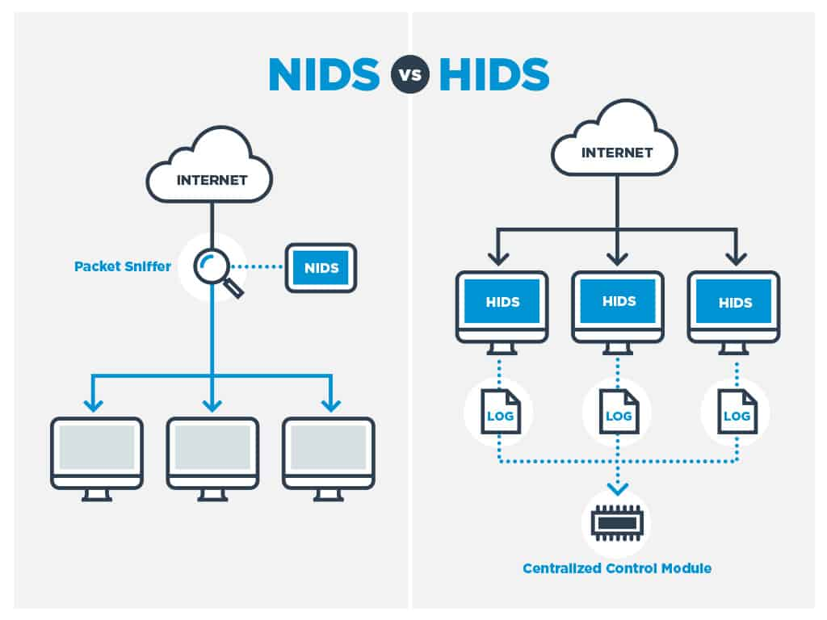
Types of Intrusion Detection Systems
Source: cyber security, G Padmavathi, swayam

Slide 84
Types of Intrusion Detection
System
(NIDS) : A network intrusion detection system is deployed at a strategic point or points within the network, where it can monitor inbound and outbound traffic to and from all the devices on the network.
(HIDS) : A host intrusion detection system runs on all computers or devices in the network with direct access to both the internet and the enterprise's internal network.
A HIDS has an advantage over an NIDS in that it may be able to detect anomalous network packets that originate from inside the organization or malicious traffic that an NIDS has failed to detect.
A HIDS may also be able to identify malicious traffic that originates from the host itself, such as when the host has been infected with malware and is attempting to spread to other systems.

Slide 85

Components of Intrusion Detection
System
Decision Table
Alarm
Detection Engine
Monitors
Malicious
Detection
Response
Configuration
Sensor
Decision Engine
Hosts and Networks
Manages and Reports
Information Recorded
Action
Report
Management Console
Source: cyber security, G Padmavathi, swayam

Slide 86
Objective of Topics
Topic | Objective | CO Mapping
Backup Security Measures | Study of concept of Backup Security Measures | CO3

Slide 87
Backup Security Measures (CO3)
Data backups are taken to secure important data files and systems from being lost due to natural disasters or human errors and recover in case any kind of disaster has led to the loss of information. Therefore, it is very important to secure data backups.
Following practices should be performed for maintaining proper data backup security-
– Assigning responsibility, authority and accountability.
– Assessing risks.
– Developing data protection processes.
– Communicating the processes to the concerning people.
– Executing and testing the process.

Slide 88
Backup Security Measures
Assign Accountability, Responsibility and Authority
Make storage security a function of overall information security policies and architecture
Divide duties where data is highly sensitive.
Ensure that the person authorizing access is not the person charged with responsibility for execution.
2. Assessing Risk
Perform a Risk Analysis of the Entire Backup Process.
Execute a Cost/Benefit Analysis on Backup Data Encryption
Identify Sensitive Data.

Slide 89
Backup Security Measures
3. Develop Data Protection Process
Adopt a Multi-Layered Security Approach
Authentication: Authorization: Encryption Auditing:
Copy Your Backup Tapes
4. Communicating the processes to the concerning people
It is important to ensure that the people responsible for carrying out its security are informed and trained.
• Security policies are the most important aspect of assigning accountability, responsibility and authority.
5. Executing and testing the process
Once the end-to-end plan has been developed, defined and communicated to the appropriate people, it is time to begin execution and testing process.

Slide 90
Daily Quiz
What is Biometric security?
Differentiate authentication and authorization.
What are Security Issues with Hardware?
What is memory protection?
What are the Open and Closed Systems?

Slide 91
Weekly Assignment
What do you mean by Application Security? Name the two protocol use for Email Security and Explain?
Elaborate the term access control? What is include in authorization process for (File, Program, Data rights) and explain the all types of control?
Define Vendor challenges and user challenges for application security?
Write a short note on data disposal.
What do you mean by physical security of IT assets?
Explain Information security governance.
Write design Security Issues in Hardware, Data Storage & Downloadable Devices?
What are the different Measures of Backup Security
What are the different types of Biometric?
Explain the Principles for Secure System Design.

Slide 92
Topic Links
https://youtu.be/snJGzyXzVec
https://youtu.be/8caqok3ah8o
https://youtu.be/WPU2eisvqXE
https://youtu.be/cUvMIOdaSBs
https://youtu.be/0a264Edp5l0
https://youtu.be/Ye2H1n2MtIc
https://youtu.be/xwgecIX3E4I

Slide 93
MCQ s
Secure information systems are developed by:
a)Integrating security with the system after it has been
developed
b) Never integrating security with the information system
c) Keeping security as a separate action until the last step of
the system development
d) Integrating risk analysis and management activities at
the start of the system development lifecycle and
continuing throughout the cycle
Which of the following is a control gate in the development phase?
a) Authorizing the decision
b) Reviewing the architecture and design
c) Reviewing the confidentiality and availability
d) Reviewing the operational readiness

Slide 94
MCQ s
The risk management process involves:
a) Framing, deciding, executing, and deleting
b) Framing, assessing, monitoring, and responding
c) Monitoring, assessing, executing, and deleting
d)All of the above
Which of the following is used to provide physical security of IT assets?
a) Physical access control technique
b) CCTV surveillance technique
c) IDS technique
d) None
Which of the following is a part of the secure system design?
a) Layering b)Abstraction
c) Security domains d) None

Slide 95
MCQ s
Which of the following is an issue faced by data storage devices?
a) Excessive data mounting
b) Theft, destruction, and damage
c) Too small size
d) All of the above
Express the correct relationship between vulnerabilities, threats and risks.
a) Risk=threat x vulnerability b) Threat=risk x vulnerability
c) Vulnerability=risk +threat d) Risk=threat – vulnerability
Characterize the type of hackers who use their knowledge for good purposes.
a) Black hat b)White hat
c) Gray hat d)Blue hat

Slide 96
Glossary Questions
Fill the right options:
Intrusion Detection System, NIDS and HIDS, Software Development Life Cycle, Responding to the risks, CCTV
IDS stands for ____________
2. IDS can be broadly classified as ______ and ______.
3. SDLC stands for _________.
To take preventive or corrective measures so that systems can be kept protected from any kind of threats, whether internal or external is ________
__________ is used for physical security of an organization.

Slide 97
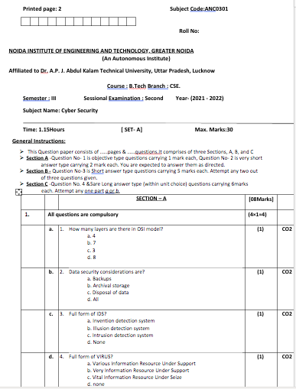
Past Sessional Papers

Slide 98
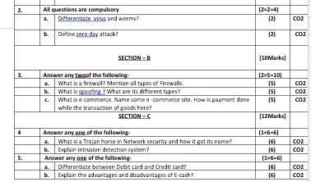
Past Sessional Papers

Slide 99
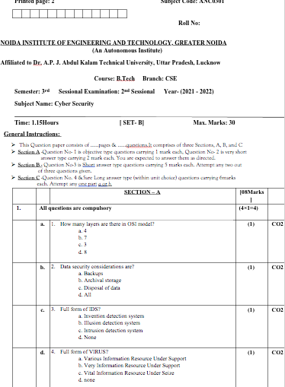
Past Sessional Papers

Slide 100
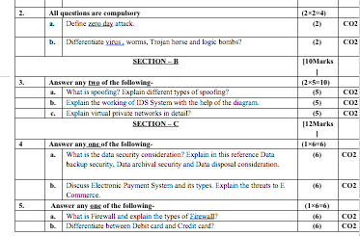
Past Sessional Papers

Slide 101
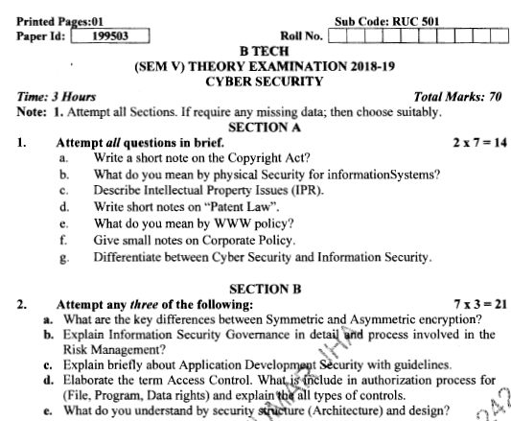
Old Question Papers

Slide 102
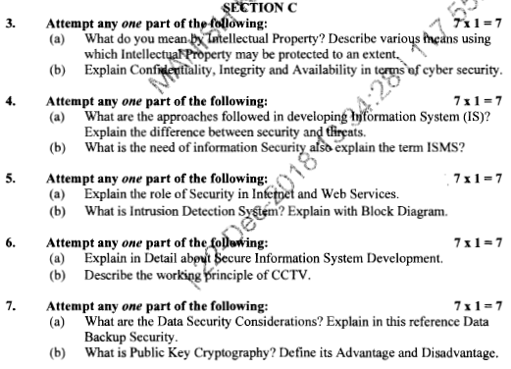
Old Question Papers

Slide 103
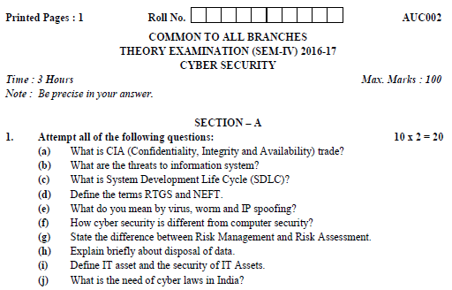
Old Question Papers

Slide 104
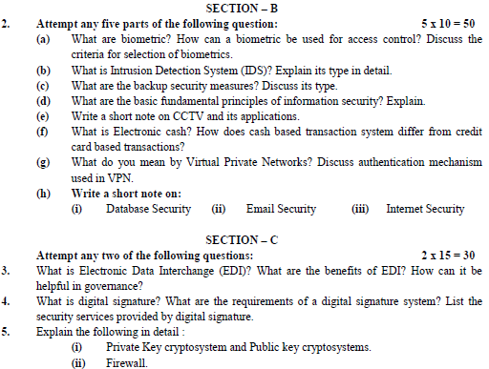
Old Question Papers

Slide 105
Expected Questions for University Exam
Do vulnerabilities play a vital role in cyber security? Justify
Elaborate the term access control? What is include in authorization process for (File, Program, Data rights)?
Describe in brief the application development security.
Describe Risk Management Process.
Discuss backup security measures Types
What do you mean by Security Architecture & Design

Slide 106
Recap of Unit
The major topics covered are Application Development Security, Information Security Governance & Risk Management, Security Architecture & Design Security Issues in Hardware, Data Storage & Downloadable Devices, Physical Security of IT Assets, Backup Security Measures.
Biometric technology has proved itself as a powerful alternative to traditional password-based and token-based authentication technology.

Slide 107
References
Charles P. Pfleeger, Shari Lawerance Pfleeger, “Analysing Computer Security ”, Pearson Education India.
V.K. Pachghare, “Cryptography and information Security”, PHI Learning Private Limited, Delhi India.
Dr. Surya Prakash Tripathi, Ritendra Goyal, Praveen kumar Shukla ,”Introduction to Information Security and Cyber Law” Willey Dreamtech Press.(prefer)
https://link.springer.com/content/pdf/10.1007/978-0-387-73269-5_6.pdf
http://www.m2sys.com/blog/biometric-resources/what-are-the-biometrics-
https://onlinecourses.swayam2.ac.in/cec20_cs09/unit?unit=59&lesson=66

Slide 108
Thank You

